Slide 1



School of Information Technology
https://www.monash.edu.my/
FIT5226
Multi-agent System & Collective Behaviour
Week 6: Classical Game Theory (Into)
FIT5226-S2-2024
Prepared by: Bernd Meyer. Edited by: Fuad Noman
www.monash.edu.au

Slide 2
Acknowledgements
This material includes content adapted from instructional resources made available by the authors of our main textbook, Chapter 3 “Multiagent Systems”, Yoav Shoham and Kevin Leyton-Brown, Cambridge University Press, 2009.

Slide 3
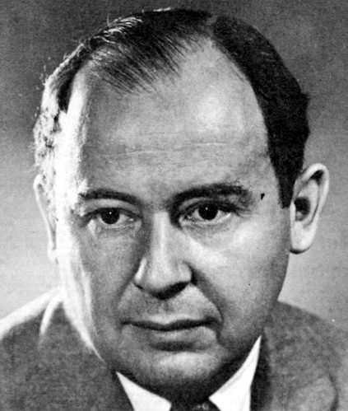
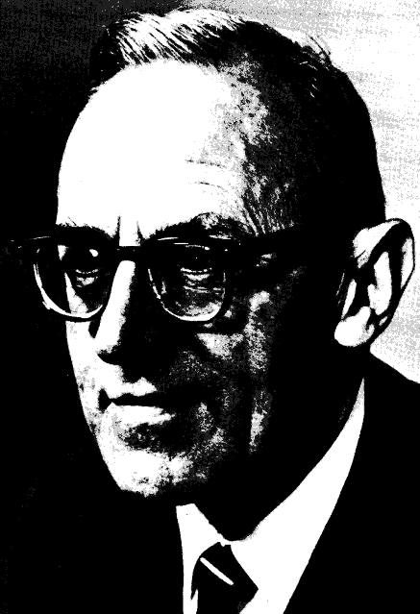

Classical (Economic) Game theory
John von Neumann & Oskar Morgenstern (1944) Theory of Games and Economic Behavior
John von Neumann
Oskar Morgenstern
John Nash
Notes:
Emile Borel and the Minimax Theorem (1921): Emile Borel, a French mathematician, introduced the concept of mixed strategies and the minimax theorem in his work on two-player, zero-sum games. The minimax theorem states that in a zero-sum game (where one player's gain is another player's loss), under certain conditions, there exists an equilibrium strategy where each player's best response minimizes the maximum potential loss.
John von Neumann and Oskar Morgenstern's "Theory of Games and Economic Behavior" (1944): Often considered the birth of classical game theory, von Neumann and Morgenstern's book laid out the fundamental concepts and mathematical foundations of game theory. They introduced concepts like utility theory, Nash equilibrium, and defined various types of games, such as cooperative and non-cooperative games.
Nash Equilibrium (1950): John Nash, an American mathematician, introduced the concept of Nash equilibrium in a series of papers. A Nash equilibrium is a situation where each player's strategy is optimal given the strategies chosen by the other players. Nash's work provided a deeper understanding of non-cooperative games and their stable outcomes.

Slide 4
Game Theory
History
1921-1927:
First approaches (E. Borel)
1928:
J. von Neumann: “Zur Theorie der Gesellschaftsspiele” in Mathematische Annalen Vol. 100
1944:
J. von Neumann and O. Morgenstern:
“Theory of Games and Economical Behaviour”, Princeton University Press
The defining Volume
1950:
PhD John Nash (27 pages!)
Original Interest: Economy and Warfare --- Strategy selection

Slide 5
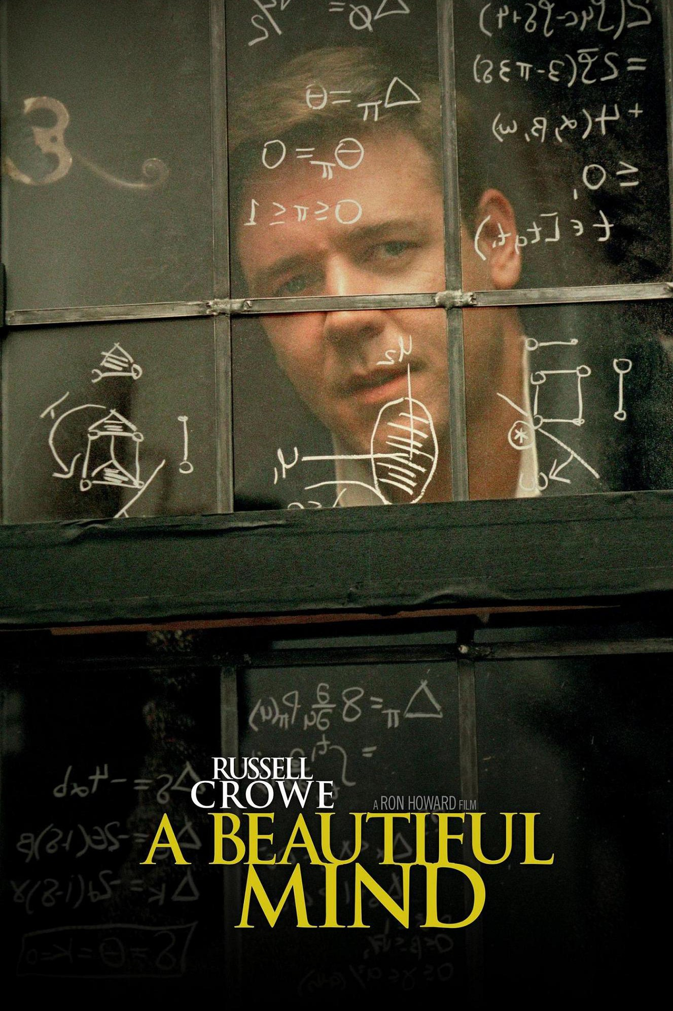

Slide 6
Non-cooperative Game Theory
Strategic interaction between rational, self-interested agents
non-cooperative means:
The individual is the basic actor,
Individuals pursue their own interests
cooperative or coalition game theory investigates how agents form coalitions and teams
Notes:
Classical game theory is a branch of mathematics and economics that deals with the analysis of strategic interactions among individuals or entities. It provides a framework for understanding decision-making in situations where the outcome of one participant's choice depends on the choices of others.
Noncooperative game theory is a branch of game theory that focuses on analyzing strategic interactions among individuals or entities where cooperation is not explicitly assumed or enforced. In noncooperative games, players make decisions independently, aiming to maximize their own individual utilities without direct communication or coordination with other players.
Cooperative game theory is a branch of game theory that focuses on studying situations where groups of players can form coalitions and collaborate to achieve joint outcomes.
In non-cooperative game theory, players make decisions independently, without any binding agreements or coordination. Each player aims to maximize their own individual utility without considering the collective benefits or the choices of other players.
Key characteristics of non-cooperative games include:
Players act independently without forming coalitions.
Focus on individual utility maximization.
Analysis of strategic interactions among players, often resulting in equilibria such as Nash equilibrium.
In non-cooperative games, players are generally assumed to be self-interested and make decisions based on their preferences and strategic considerations.

Slide 7
Biological and Ecological Games
Notes:
Biological and ecological games are a genre of video games that focus on simulating and exploring various aspects of the natural world, ecosystems, and the interactions between different species. These games often aim to provide players with insights into the complexities of biology, environmental science, and ecological relationships, while also offering an engaging and educational gameplay experience. Here are a few examples of biological and ecological games.
Beetles are a diverse group of insects that can be found in a wide range of ecosystems around the world. Competition for food is a common ecological phenomenon among beetles, as they often share habitats with other species that also require the same resources. Understanding the dynamics of competition for food among beetles contributes to our broader understanding of ecological interactions and the intricate relationships that shape ecosystems. It also provides insights into the strategies beetles employ to survive and thrive in a competitive natural world.

Slide 8
Competition for food
When beetles of the same size compete, they get equal shares of the food
When a large beetle competes with a small beetle, the large beetle gets the majority of the food.
But being large is not only positive: large beetles experience less of a fitness benefit from a given quantity of food, since some of it is diverted into maintaining their expensive metabolism

Slide 9
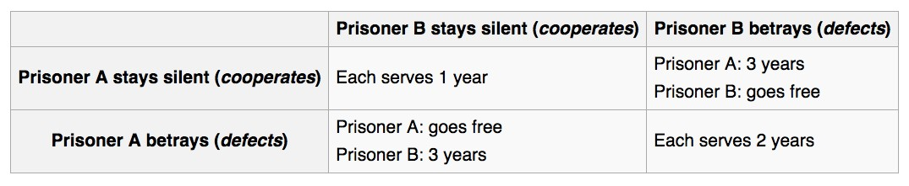
Prisoners’ Dilema
An Example of a cooperative, non-zero sum game
Situation: The police arrests two suspects, but has only little evidence.
Both suspects are imprisoned in isolation and offered
a “deal”. If either acts as witness against the other one he is offered a reduced sentence.
•If both remain silent (cooperate with each other), they gain a little.
•If both talk, both are punished harder as if both remain silent.
•If A “talks” (=defects) and B remains silent (=cooperates with A), A gains most at the expense of B.
Dilemma: If either player reacts “fully rationally” he/she would always defect (talk). However, the “irrational” hope is that the other one will also cooperate.
Such games become more even more interesting if they are iterated, so that A/B can gain information about B/A’s strategy. (Without it being known when the game ends!)
Week-6
Notes:
The Prisoners' Dilemma is a classic concept in game theory that illustrates a situation in which two individuals, when faced with a decision to cooperate or betray each other, often make choices that are not individually optimal for both of them, leading to a suboptimal outcome for both parties.
Two suspects, A and B, are arrested for a crime but are being held separately. The police don't have enough evidence to convict them of the main charge, but they suspect both suspects are guilty of a lesser offense. The police offer each suspect a deal:
If both A and B stay silent (cooperate), both will be convicted of the lesser offense, leading to a moderate sentence for each.
If A stays silent while B betrays (defects), A will receive a heavy sentence while B goes free.
If B stays silent while A betrays, B will receive a heavy sentence while A goes free.
If both A and B betray (defect), both will receive a moderately heavy sentence.

Slide 10



A Biological Prisoner’s Dilemma
Notes:
The Prisoners' Dilemma can also be applied to certain biological scenarios, and one example involves cleaning mutualism among fish, particularly in the context of cleaner fish and their interactions with client fish.
Cleaner fish are species that have evolved to remove parasites and dead skin from other fish, known as client fish. This mutualistic interaction benefits both the cleaners (who get a meal) and the clients (who get rid of parasites). However, there's a potential for a Prisoners' Dilemma-like situation to arise:
If both the cleaner fish and the client fish cooperate, the cleaner benefits from a meal, and the client benefits from parasite removal.
If the cleaner fish cooperates by cleaning, but the client fish defects by not providing any food reward, the cleaner loses out on a meal without receiving any benefits.
If the cleaner fish defects by attempting to consume the client fish, it gains a meal, but the client fish loses out on parasite removal.
In this scenario, both cleaner and client fish face a decision whether to cooperate (clean/feed) or defect (not clean or not provide food). The outcome matrix might look like this:
| Client Cooperates | Client Defects
-------------------------------------------------
Cleaner | +3, +3 | -1, +4
-------------------------------------------------
Defect | +4, -1 | +1, +1
The numbers represent the benefits (or payoffs) for each outcome. Positive numbers indicate benefits, while negative numbers represent costs.
Just as in the traditional Prisoners' Dilemma, the optimal strategy for an individual cleaner fish, regardless of what the client fish does, would be to defect (attempt to consume the client). This would provide a meal for the cleaner fish even if the client fish is harmed in the process. However, if both cleaner and client cooperate, the overall benefit is maximized for both parties.
This scenario mirrors the Prisoners' Dilemma because the self-interested choices of both parties (cleaner and client) can lead to a suboptimal outcome where both parties lose out (as seen in the case of the cleaner fish defecting). It highlights the delicate balance between cooperation and self-interest in mutualistic relationships in the biological world.

Slide 11
Self-interested Agents
Each Agent
has their own description of states that they would like to reach
and choses their actions according to these target states
this does not necessarily means that the agent is selfish (unwilling to cooperate) or acts against others
agents independently maximise their own ‘utility’ (“rationality”)
Notes:
Self-interested agents refer to individuals or entities that make decisions and take actions based on their own interests, often with the goal of maximizing their own benefits, gains, or well-being. These agents act rationally to achieve their own objectives, and their decisions are typically influenced by factors such as personal preferences, goals, constraints, and the perceived outcomes of their actions.
Self-interested behavior is a fundamental concept in various fields, including economics, game theory, sociology, and artificial intelligence.

Slide 12
Example: friends and enemies
Alice choses her destination for the evening
She can go to to club, the movies, or stay home and watch netflix
her utility for these by herself is: club: 100, movies: 50; home: 50 Alice dislikes Bob but likes Carol.
If she goes out, she might bump into either
Bob is at the club 60% of the time, and at the movies otherwise Carol is at the movies 75% of the time, and at the club otherwise
If Alice runs into Bob at the movies or the club, her utility is only 10 If Alice sees Carol, her utility increases by a factor 1.5
Notes:
Utility represents the subjective value or satisfaction that individuals derive from different outcomes or choices. In game theory, utility functions are used to quantify the preferences of players in a game and help predict their decisions.

Slide 13
Example: friends and enemies (Continued …)
60%
B = c
40%
B = m
B = c
B = m
C = c
25%
15 | 150
10 | 100
50 | 10
75 | 15
C = c
C = m
75%
C = m
A = c
A = m
Alice’s expected utility for home (h): 50
Alice’s expected utility for club (c):
0.25(0.6 · 15 + 0.4 · 150) + 0.75(0.6 · 10 + 0.4 · 100) = 51.75.
Alice’s expected utility for movies (m):
0.25(0.6 · 50 + 0.4 · 10) + 0.75(0.6(75) + 0.4(15)) = 46.75.
A prefers the club (though Bob is likely to be there and Carol is not), she prefers staying home to the movies (though Carol almost always is there).
Notes:
Alice has three options: going to the club (c), going to the movies (m), or staying home (h). Her preferences for these options are as follows:
Utility for club (c): 100
Utility for movies (m): 50
Utility for home (h): 50
Alice's dislike for Bob and preference for Carol are considered in the expected utilities based on the probabilities of encountering them at the club or the movies.
Probabilities of Bob and Carol's locations:
Bob at the club: 60%
Bob at the movies: 40%
Carol at the movies: 75%
Carol at the club: 25%
Utility adjustments based on encounters:
Meeting Bob or Carol: -90 (utility reduces from 100 to 10)
Meeting Carol: *1.5 (increases utility by 50%)
Now, let's calculate the expected utilities for each option:
Going to the Club (c):
Probability of Bob and Carol being at the club: 0.60 * 15 = 9
Probability of Bob at movies when Carol at club: 0.40 * 150 = 60
Probability of Bob at club and Carol at movies: 0.6 * 10 = 6
Probability of Carol and Carol being at the movies: 0.4 * 100 = 40
Expected utility for club: 0.25 * (9 + 60) + 0.75 * (6 + 40) = 51.75
Going to the Movies (m):
Probability of Bob and Carol being at the club: 0.60 * 50 = 30
Probability of Bob at movies when Carol at club: 0.40 * 10 = 4
Probability of Bob at club and Carol at movies: 0.6 * 75 = 45
Probability of Carol and Carol being at the movies: 0.4 * 15 = 6
Expected utility for movies: 0.25 * (30 + 4) + 0.75 * (45 + 6) = 46.75
Staying Home (h):
No encounters, so utility remains 50
Comparing the expected utilities:
Club (c): 51.75
Movies (m): 46.75
Home (h): 50
Based on these calculations, Alice's best option in terms of expected utility is to go to the club, as it provides the highest expected utility among the available choices. This analysis takes into account her preferences for different activities, her dislike for Bob, and her preference for Carol's company, along with the probabilities of encountering each of them.

Slide 14
Utility Theory
Is it sensible (sufficient) to describe an agent’s preferences as a utility (numerical) function?
Start from the comparison of only two outcomes by an agent
O1 ~ O2: O1 >= O2: O1 > O2:
no preference
weak preference “O1 is at least as desirable as O2”
strict preference
Notes:
utility theory is a concept that quantifies the preferences of individuals or players in a strategic interaction. It provides a way to assign numerical values, called utilities, to different outcomes in a game, reflecting the subjective satisfaction or desirability of those outcomes for each player. Utility theory is used to model and analyze decision-making processes in games where players make choices to maximize their own preferences.

Slide 15
Lottery
Define a lottery that assigns probabilities to random outcomes
L = [p₁ : o₁, p₂ : o₂, …, p_{n} : o_{n}]
We can now consider a whole lottery as an outcome
Notes:
a "lottery" typically refers to a situation where players make choices among various uncertain outcomes, each with associated probabilities. Lotteries are used to model scenarios of risk and uncertainty, where players must decide how to allocate their choices to maximize their expected utility.
Outcome: An outcome represents a possible result or consequence of a decision or event. It can be a tangible result or a state of the world that is uncertain. For example, winning a game, receiving a monetary payoff, or experiencing a particular event are all outcomes.
Utility: Utility is a measure of the desirability or satisfaction that an individual derives from different outcomes. Each outcome is associated with a utility value that reflects the individual's preference for that outcome. Higher utility values correspond to more preferred outcomes.
Lottery: A lottery is a collection of outcomes, each with an associated probability of occurring. Lotteries model situations of uncertainty where an individual faces different possible outcomes, each with a certain likelihood. A lottery represents a scenario where the individual is uncertain about which specific outcome will occur.

Slide 16
Axioms 1/2
In game theory and decision theory, axioms are fundamental principles or assumptions that guide the development and analysis of models for making decisions.
Completeness: a preference is defined between any two outcomes
Transitivity: o₁ ≻ o₂ ∧ o₂ ≻ o₃ ⟹ o₁ ≻ o₃
Monotonicity:
o₁ ≻ o₂ ∧ p > q ⟹ [p : o₁, 1 − p : o₂] ≻ [q : o₁, 1 − q : o₂]
Decomposability
Let p(L_{i}, o_{j}) denote the outcome assigned to o_{j} in lottery L_{i}
∀j : p(L₁, o_{j}) = p(L₂, o_{j}) . ⟹ . L₁ ∼ L₂
Notes:
In game theory and decision theory, axioms are fundamental principles or assumptions that guide the development and analysis of models for making decisions. When it comes to lotteries and outcomes, several axioms are commonly used to define rational decision-making under uncertainty. These axioms help establish the foundations for expected utility theory, which is a key framework in understanding how individuals make decisions involving risk and uncertainty. Here are some of the key axioms related to lotteries and outcomes:
Completeness Axiom: This axiom states that a decision-maker can compare and rank all possible outcomes. In other words, given any two outcomes, the decision-maker can determine their preferences or indicate that they are indifferent between the two.
Transitivity Axiom: This axiom stipulates that if a decision-maker prefers outcome A to outcome B and prefers outcome B to outcome C, then they must also prefer outcome A to outcome C. It ensures that preferences are logically consistent and do not lead to cycles of contradictory choices.
Monotonicity Axiom: Monotonicity asserts that more of a good is always better. If outcome A is preferred to outcome B, then receiving more of outcome A should be even more preferred.
Decomposability Axiom: This axiom states that if a decision-maker is indifferent between two lotteries A and B, and they are also indifferent between two other lotteries C and D, then the decision-maker should also be indifferent between a compound lottery that combines A and C with the same probabilities and a compound lottery that combines B and D with the same probabilities. In other words, preferences for combined lotteries should be consistent with preferences for individual lotteries.

Slide 17
Axioms 2/2
Substitutability:
o₁ ∼ o₂ ⟹
[p : o₁, p₃ : o₃, … , p_{k} : o_{k}] ∼ [p : o₂, p_{3 :} o₃, … , p_{k} : o_{k}]
Continuity:
o₁ ≻ o₂ ∧ o₂ ≻ o₃
⟹ ∃p : o₂ ∼ [p : o₁, 1 − p : o₃]
Notes:
∃, means there exists
Substitutability Axiom: The substitutability axiom asserts that if a decision-maker prefers one lottery A to another lottery B, and they also prefer a third lottery C to a fourth lottery D, then the decision-maker should prefer a compound lottery that combines A and C with the same probabilities to a compound lottery that combines B and D with the same probabilities. This axiom captures the idea that when two lotteries have preferred components, combining them in a compound lottery should also be preferred.
Continuity Axiom: The continuity axiom states that if a decision-maker prefers outcome A to outcome B and outcome B to outcome C, there exists a probability p between 0 and 1 such that the decision-maker is indifferent between a lottery that gives outcome A with probability p and outcome C with probability 1-p, and outcome B.
These axioms collectively lay the foundation for expected utility theory, which quantifies preferences over lotteries and outcomes by assigning utilities to each possible outcome. By adhering to these axioms, decision-makers can make choices that are consistent, rational, and in line with their underlying preferences.
Expected utility theory, based on these axioms, is a powerful tool for analyzing decision-making under uncertainty and provides insights into how individuals weigh different outcomes and probabilities to make rational choices.

Slide 18
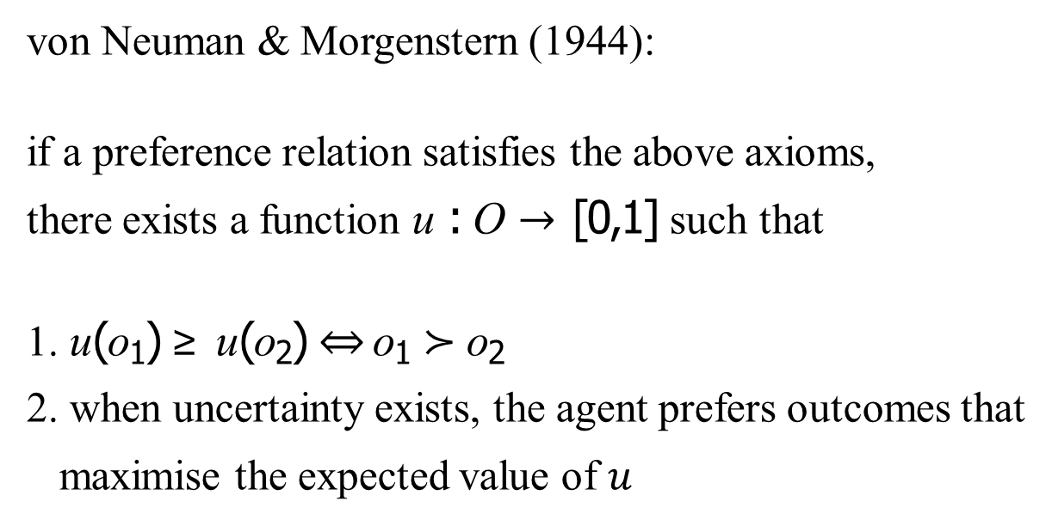
Utility Theorem
von Neuman & Morgenstern (1944):
if a preference relation satisfies the above axioms, there exists a function u : O → [0,1] such that
1. u(o₁) ≥ u(o₂) ⇔ o₁ ≻ o₂
2. when uncertainty exists, the agent prefers outcomes that maximise the expected value of $u$
The theorem addresses how individuals make choices when faced with uncertain outcomes and how they evaluate and compare different lotteries or uncertain scenarios.
Notes:
The Utility Theorem, proposed by John von Neumann and Oskar Morgenstern in their groundbreaking book "Theory of Games and Economic Behavior" in 1944, laid the foundation for modern decision theory and the study of rational decision-making under uncertainty.
This theorem established the mathematical framework for expected utility theory, which is a fundamental concept in economics, game theory, and various other fields.
The theorem addresses how individuals make choices when faced with uncertain outcomes and how they evaluate and compare different lotteries or uncertain scenarios.

Slide 19
Example Games: pure competition
Players have exactly opposing interests
Only two players (otherwise, what does exactly opposing mean?)
Let u_{i} be the utility for Player i
∃c ∀a ∈ A : u₁(a) + u₂(a) = c
∃c: There exists a value c.
∀a ∈ A: For all possible actions a that players can take, where a belongs to the set A of possible actions.
u₁(a): The utility (payoff) function of Player 1 for action a.
u₂(a): The utility (payoff) function of Player 2 for action a.
Notes:
Pure competition in game theory refers to situations where the outcomes of players' actions are entirely determined by the strategies of other players, without any cooperative elements. In these games, the interests of players are directly opposed to each other, and each player's success comes at the expense of others. Here are a few examples of games that exhibit pure competition:
Zero-Sum Games:
Chess: In chess, players compete directly against each other. The gain of one player is the loss of the other. There is no possibility of cooperation, and the objective is to checkmate the opponent's king.
Poker: In poker, players compete for a finite pot of money or chips. One player's winnings come directly from the losses of other players. It's a classic example of a competitive game with incomplete information.
Sports Matches:
Football (Soccer): A football match is a pure competition where two teams compete to score more goals than the other. The team that scores more goals wins, and there is no cooperation between the teams during the match.
Tennis: In singles tennis, two players compete to win points and games. The winner of each point gains at the expense of the opponent, and the objective is to win more games and sets.
Economic Competition:
Auction: Auctions are competitive processes where participants bid against each other to acquire a specific item. The highest bidder wins, and their gain is at the cost of the other bidders.
Cournot Duopoly: In this economic model, two companies compete by setting quantities of output. The profit of one company depends on its own output and the output of the other company. Both companies aim to maximize their own profits, which can lead to competition and strategic decisions.
Resource Allocation:
Tragedy of the Commons: This scenario involves the competition for shared resources, such as grazing land or fishing grounds. Individuals may act in their own self-interest and deplete the resource, leading to negative outcomes for all.
Race or Contest:
Sprint Race: A sprint race involves individual participants racing against each other to reach a finish line. The first person to cross the line wins, and the objective is to be faster than the competition.
These examples demonstrate situations where players' interests are directly opposed, and there is little to no room for cooperation or collaboration. In pure competition, success is achieved by outperforming others rather than by working together.
The equation u1(a) + u2(a) = c represents a situation where the sum of the utilities of the two players for a given action a is equal to a constant value c. This constant c indicates the total value that is being competed for or shared between the players in the game.
In essence, this notation captures the idea that the combined utilities of both players for any given action must sum up to a fixed value, which could represent a limited resource, a prize, or a score in a competitive game. This aligns with the concept of pure competition, where players' interests are in direct opposition to each other, and their gains and losses are interdependent.

Slide 20
Two-person Zero-sum games
Two-person Zero-sum games are the best-understood form of games. These games are a special case of pure competition.
Two players take turns in making a choice from a set of possibilities
Three possible outcomes:
draw (no one wins anything)
player A wins $x which are paid by player B
player B wins $y which are paid by player A

Slide 21
Matching Pennies
Each player shows one side of a coin.
To win, one player must match, the other mismatch
H T
H
T
1 | ­-1
-1 | 1
The number in each cell represents the payoff for Player 1.
Notes:
The payoffs are assigned based on the following logic:
If both players choose the same side (both heads or both tails), Player 1 wins, and Player 2 loses. The payoffs are (1, -1) for Player 1 and (-1, 1) for Player 2.
If the players choose different sides, Player 2 wins, and Player 1 loses. The payoffs are (-1, 1) for Player 1 and (1, -1) for Player 2.

Slide 22
Rock-Paper-Scissors
Generalised matching pennies
Rock
Paper
Scissors
0 | -­1 | 1
1 | 0 | ­-1
-­1 | 1 | 0
Rock
The number in each cell represents the payoff for Player 1.
Paper
Scissors
Rock beats scissors (rock crushes scissors).
Scissors beats paper (scissors cut paper).
Paper beats rock (paper covers rock).
Notes:
Like the matching pennies game, Rock-Paper-Scissors is a game of pure competition. Each player's success comes at the expense of the other player. The game is also interesting from a strategic perspective. There is no dominant strategy for either player, meaning that the best move for a player depends on what the opponent plays. In the absence of a clear dominant strategy, players often use mixed strategies (randomized choices) to create unpredictability and minimize the opponent's ability to predict their moves.
The Rock-Paper-Scissors game has become a common example in discussions of game theory due to its simplicity and the strategic considerations it presents. It's a classic example of a game where the outcome is determined solely by the choices of the players and their interactions.

Slide 23

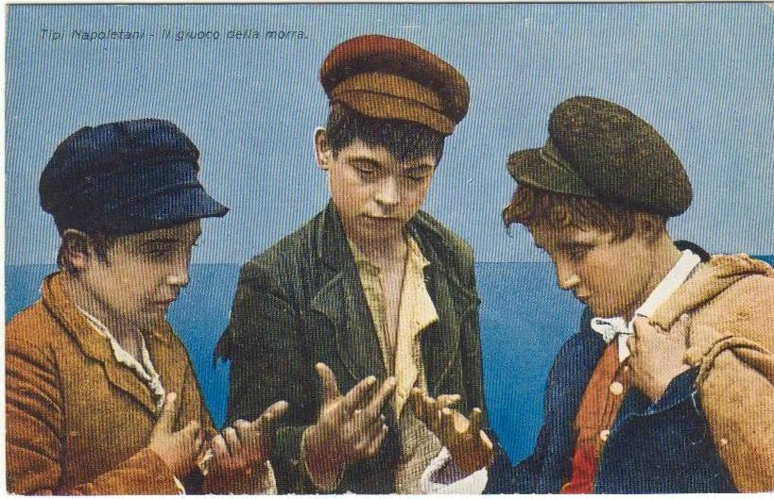
Morra
Each Player hides one or two coins.
Each player guesses how many coins the opponent has hidden.
There is a win if and only if one player guesses correctly, the other one incorrectly.
In case of a win, an amount equal to the total number of hidden coins is paid to the winner.
FIT5226-S2-2024
Notes:
The key strategic element in this game is the decision to hide either one or two coins and the subsequent guess based on what the opponent might have done. Players need to consider their opponent's possible choices and use randomization to make their guesses less predictable.
For example, if a player always hid and guessed two coins, the opponent could exploit this by always hiding and guessing one coin. To counteract this, players might randomize their choices, such as hiding one coin half the time and two coins the other half, and making corresponding guesses.
The concept of mixed strategy Nash equilibrium comes into play when players choose to randomize their actions to make it difficult for the opponent to exploit a predictable pattern. In equilibrium, neither player has an incentive to unilaterally deviate from their strategy, given the strategy of the opponent.
This game highlights the strategic interplay between hiding, guessing, and randomizing choices. It's a simple yet illustrative example of the complexities that can arise in competitive decision-making when hidden information is involved.

Slide 24
Morra Payoff Matrix
Strategies for both players:
 |  |  | (1/ 1) | (1/ 2) | (2 /1) | (2 / 2)
(1/1) | Hide one coin, guess “one coin” | (1 /1) | 0 | 2 | −3 | 0
(1/2) | Hide one coin, guess “two coins” | (1/ 2) | −2 | 0 | 0 | 3
(2/1) | Hide two coins, guess “one coin” | (2 / 1) | 3 | 0 | 0 | −4
(2/2) | Hide two coins, guess “two coins” | (2 / 2) | 0 | −3 | 4 | 0
As this is zero-sum, a single matrix is enough to denote the outcomes (instead of a bi-matrix notation, i.e. (m, n))
We speak of the “column player” and the “row player”.
the pay-off is given for the row player (by convention)
the row player tries to maximize the outcome
column player tries to minimize the outcome
Notes:
The key strategic element in this game is the decision to hide either one or two coins and the subsequent guess based on what the opponent might have done. Players need to consider their opponent's possible choices and use randomization to make their guesses less predictable.
For example, if a player always hid and guessed two coins, the opponent could exploit this by always hiding and guessing one coin. To counteract this, players might randomize their choices, such as hiding one coin half the time and two coins the other half, and making corresponding guesses.
The concept of mixed strategy Nash equilibrium comes into play when players choose to randomize their actions to make it difficult for the opponent to exploit a predictable pattern. In equilibrium, neither player has an incentive to unilaterally deviate from their strategy, given the strategy of the opponent.
This game highlights the strategic interplay between hiding, guessing, and randomizing choices. It's a simple yet illustrative example of the complexities that can arise in competitive decision-making when hidden information is involved. In this matrix:
The rows represent the player's choices for hiding coins.
The columns represent the player's choices for guessing the opponent's hidden coins.
The values in the matrix represent the payoffs for the player who guesses.
For example, if the player hides 1 coin and guesses that the opponent hides 2 coins, the payoff for the guessing player would be 3.
This matrix can be used to analyze the game using various game theory concepts, such as Nash equilibrium. Players will aim to choose strategies that maximize their expected payoffs while considering their opponent's possible actions. They might use mixed strategies (randomized choices) to create unpredictability and gain a strategic advantage.
In the provided matrix, the entry at the intersection of row (1/1) and column (1/1) indeed shows a payoff of 0. This indicates that when both players choose to hide 1 coin and both players guess that the opponent has hidden 1 coin, the game results in a tie, and neither player wins or loses any amount.
This makes sense in the context of the game. If both players have the same number of hidden coins and both players guess the same number of coins, then their guesses are correct, and there's no net payoff for either player. It's a situation where neither player gains an advantage over the other.
The 0 payoff in this case highlights the equilibrium between the choices made by both players. It's a reflection of the symmetric nature of the game, where both players have the same information and both have an equal chance of winning or losing based on their guesses.

Slide 25
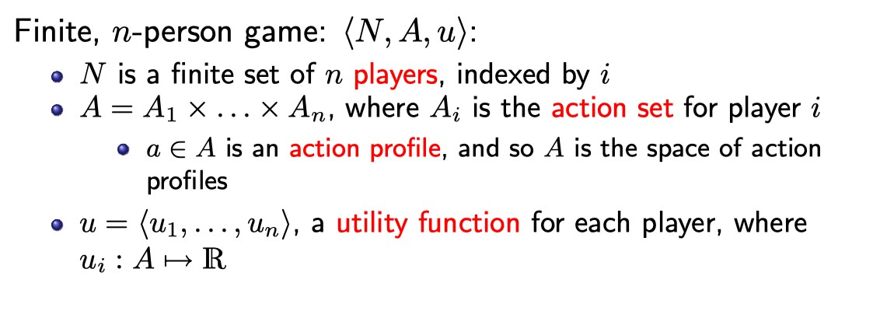
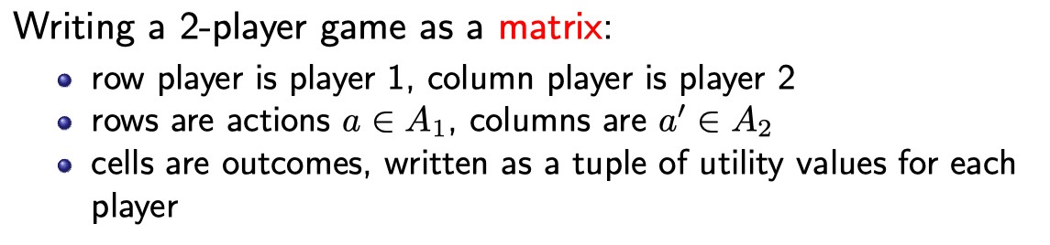
Defining Games
FIT5226-S2-2024

Slide 26
GT - RL Terminology
Game Theory | Reinforcement Learning
Player | Agent
Action | Action
Payoﬀ | Reward
Strategy | Policy

Slide 27
GT utility/payoff vs RL Reward
much like the reward in RL, payoff in GT
is a scalar value,
indicates how well agent is performing
shares the underlying assumptions of utility theory
However, differences are that RL reward
is typically cumulative over time
depends on action and environment state
can be delayed
eg. investing before cashing in later
FIT5226-S2-2024
Notes:
Game Theory (GT) utility/payoff and Reinforcement Learning (RL) reward are both concepts used in different contexts to model decision-making and optimize outcomes. While they have similarities, they are used in distinct ways in their respective fields.
Game Theory (GT) Utility/Payoff:
Context: Game theory studies strategic interactions among multiple decision-makers, often referred to as players or agents, who aim to maximize their own utilities (also known as payoffs) in a competitive or cooperative environment.
Usage: Utilities represent the preferences of players over the possible outcomes of the game. Each player's utility is typically quantified in terms of numerical values that capture their individual preferences, gains, or losses.
Objective: In non-cooperative games, players seek to optimize their individual utilities while considering the choices of other players. The interactions result in equilibrium points such as Nash equilibria, where no player has an incentive to unilaterally deviate from their strategy given the strategies of others.
Reinforcement Learning (RL) Reward:
Context: Reinforcement Learning is a machine learning paradigm that involves an agent interacting with an environment to learn how to make sequential decisions in order to maximize a cumulative reward signal.
Usage: The agent receives rewards from the environment based on its actions. Rewards are scalar values that indicate the immediate benefit or desirability of the agent's action in a given state.
Objective: The agent's goal is to learn a policy (a strategy or mapping from states to actions) that maximizes the expected cumulative reward over time. This involves exploring the environment, learning from experience, and optimizing decision-making to achieve long-term goals.
Key Differences:
Scope: Game theory typically considers interactions among multiple decision-makers in well-defined scenarios, while reinforcement learning often focuses on the decision-making of a single agent within a broader environment.
Representation: In GT, utilities/payoffs are often defined based on players' preferences, and they guide players' strategic decisions. In RL, rewards are immediate numerical signals that guide the learning process of an agent.
Optimization: GT often seeks equilibrium points where players' strategies are stable and unchanging. RL seeks to find policies that lead to long-term reward maximization, often involving exploration to learn optimal actions.
Collaboration vs. Competition: GT models both collaborative and competitive scenarios. RL is commonly used in scenarios where an agent interacts with an environment and seeks to optimize its behavior.
In summary, while GT utilities/payoffs and RL rewards both capture the concept of optimizing outcomes, they are applied in different contexts (strategic interactions vs. agent-environment interactions) and serve different purposes (equilibrium analysis vs. learning optimal behavior).

Slide 28

More Example Games
Should you send your packets using correctly-implemented TCP (which has a “backoff” mechanism) or use a defective implementation (which doesn’t)?
Consider this situation as a two-player game:
both use a correct implementation: both get 1 ms delay
one correct, one defective: 4 ms delay for correct, 0 ms for defective
both defective: both get a 3 ms delay.
Notes:
TCP (Transmission Control Protocol) backoff refers to a mechanism used in computer networking, particularly in protocols like TCP, to manage congestion and prevent network overload. Congestion can occur when there's too much traffic on a network, causing delays, packet loss, and reduced performance. TCP backoff helps regulate the rate at which data is sent to the network to alleviate congestion and ensure reliable communication.

Slide 29
TCP Backoff Games
C D
C
D
-­1, ­-1 | ­-4, 0
0, ­-4 | -­3, -­3
Correct (C)
Defective (D)
Consider this situation as a two-player game:
both use a correct implementation: both get 1 ms delay
one correct, one defective: 4 ms delay for correct, 0 ms for defective
both defective: both get a 3 ms delay.

Slide 30
General From: Prisoners’ dilemma
C D
C
D
any such game with c > a > d > b
a, a | b, c
c, b | d, d
Notes:
TCP game is Prisoners’ dilemma but it depends on the ordering of the payoff tuples

Slide 31
Traffic Game
L R
L
R
1,1 | 0,0
0,0 | 1,1
which side of the road do you drive on?
Notes:
Another example of total coordination. Left hand driving vs Right hand driving.

Slide 32
Battle of the Sexes
B F
B
F
2, 1 | 0, 0
0, 0 | 1, 2
Bayley vs Football
combines elements of co-operation and of competition
Notes:
The "Battle of the Sexes" is a classic game in game theory that illustrates how individuals' preferences can lead to conflicts and coordination problems in situations that combine elements of cooperation and competition. It's often used to analyze scenarios where individuals have differing preferences but still need to coordinate their actions.
The game typically involves two players, often referred to as "Alice" and "Bob," who must independently choose between two options. The options are often labeled "A" and "B," and each player has a preference ranking for these options. The interesting aspect of the game is that the players have different preferences but still want to coordinate their choices to achieve a favorable outcome.
Here's a common setup of the Battle of the Sexes game:
Alice prefers option A and wants to go to event X.
Bob prefers option B and wants to go to event Y.
The possible payoffs or utilities could be represented as follows:
If both choose A (X), Alice gets a higher payoff (for example, 2) and Bob gets a lower payoff (for example, 1).
If both choose B (Y), Bob gets a higher payoff (for example, 2) and Alice gets a lower payoff (for example, 1).
If Alice chooses A (X) and Bob chooses B (Y), their payoffs are reversed (for example, Alice gets 1 and Bob gets 2).
If Alice chooses B (Y) and Bob chooses A (X), their payoffs are reversed (for example, Alice gets 2 and Bob gets 1).
In this scenario, both players would like to attend the same event to be together, but they have conflicting preferences about which event to attend. The challenge is to reach a coordinated decision that maximizes their combined utility.
The Battle of the Sexes game illustrates the tension between individual preferences and the desire to coordinate decisions to achieve a mutually favorable outcome. Depending on the specifics of the payoff values and players' preferences, different strategies can emerge. Nash equilibria and mixed strategies may also come into play as players seek to find the optimal balance between their preferences and coordination. The game highlights the complexities that arise when cooperation and competition are intertwined in decision-making scenarios.

Slide 33
Cooperation Games
C D
C
D
players have aligned interests,
no conflict
• ∀a ∈ A, ∀i, j, u_{i}(a) = u_{j}(a)
this is still not cooperative game theory
a, a | b, c
c, b | d, d

